Slide 1
Aflac
Medicare Supplement Insurance
Coverage is underwritten by Tier One Insurance Company, a subsidiary of Aflac Incorporated,
and is administered by Aetna Life Insurance Company.
For agent use only. Not for public use or distribution.
N2200367
EXP 9/23

Slide 2
Disclaimer
Confidential and Proprietary. This content contains information and material that is owned by Aflac and/or its licensors, and is protected by applicable intellectual property and other laws, including but not limited to copyright. By accessing, you agree not to modify, loan, sell, distribute, or create derivative works based on these materials. Any use not specifically permitted herein is strictly prohibited and may subject you to civil and criminal penalties. Aflac Medicare supplement insurance, policy series AFLMS, may not be available in all states. Information herein is considered an overview, does not provide full disclosure, and is not an exact description of any policy or rider. Furthermore, the material may not reflect the most current version of the policy or rider. Aflac’s family of insurers include Aflac, Aflac New York, Continental American Insurance Company, and Tier One Insurance Company. Aflac Medicare Supplement insurance coverage is underwritten by Tier One Insurance Company, a subsidiary of Aflac Incorporated, and is administered by Aetna Life Insurance Company.

Slide 3
About Aflac
Aflac is a Fortune 500 company, helping provide financial protection to more than 50 million people worldwide. Our customers choose Aflac because of our commitment to providing them with the confidence that comes from knowing they have assistance in being better prepared for whatever life may bring.
Now you can offer your clients various Aflac Medicare Supplement plans from a name they already know and trust.
In June 2022, AM Best affirmed the Financial Strength Rating (FSR) of A+ (Superior) of the Aflac family of companies.
Aflac is well regarded as an ethical and diverse company. Together with strong financial results, Aflac is a Fortune Most Admired Company.
These awards pertain to American Family Life Assurance Company of Columbus.
© 2022 Aflac Incorporated.
Agents appointed with Tier One Insurance Company are independent agents and are not employees of Aflac.
14

Slide 4
Medicare Supplement Insurance
Product Overview
For agent use only. Not for public use or distribution.

Slide 5
Why Medicare Supplement?
Coverage your clients can count on
When it comes to Medicare Supplement insurance, selecting the right plan is important. Aflac offers Medicare Supplement Plans A, F, G and N, each of which can help fill some of the gaps in Medicare coverage.
Your clients will benefit from:
the freedom to choose any provider that accepts Medicare, with no restrictive networks,
help paying some out-of-pocket costs for Medicare-approved services and
a household discount of 10% for eligible applicants
For more information, visit https://www.sellaflacmedsupp.com
3
For agent use only. Not for public use or distribution.

Slide 6
Why Medicare Supplement?
Coverage your clients can count on
Fill the Gaps: Medicare provides beneficial coverage for health-related expenses, but it does not cover all health care expenses. Deductibles, coinsurance and copays must be paid out-of-pocket or with private insurance. | Freedom of Choice: A Medicare Supplement plan has no restrictive networks. Clients can visit their providers of choice, including primary care physicians, specialists, and hospitals, that accept Medicare patients. Most providers are paid automatically so clients won’t have to worry about filing claims. | Manage Health Care Expenses: A Medicare Supplement plan helps with management and budgeting of health care expenses by offering predictability and stability relative to Medicare and many Medicare Advantage plans.
For more information, visit https://www.sellaflacmedsupp.com
4
For agent use only. Not for public use or distribution.

Slide 7
The Aflac Difference
Household Discount
Unlike some other carriers who only offer a Medicare Supplement household discount if each resident enrolls in their Medicare Supplement Plan, Aflac offers a 10% discount¹ if your clients meet either of the following conditions:
reside with their spouse, including civil union/domestic partner²; or
have been living with a family member who is age 50 or older for the last twelve months.
The household discount will apply to eligible applicants as long as either of these requirements are met.
¹ Reference the outline of coverage for details.
² For the purpose of this discount, a civil union partner or domestic partner will be considered a legal spouse when such partnerships are valid and recognized in your state of residence.
4

Slide 8
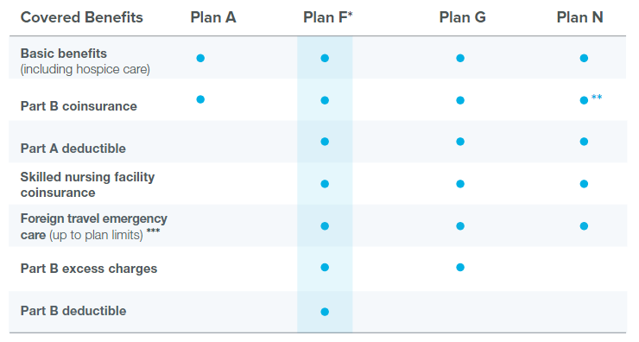
Coverage Options
Aflac offers Medicare Supplement plans A, F, G and N with varying amounts of coverage; Plan A provides basic benefits, and Plan F offers more comprehensive coverage.
Premiums also vary according to the amount of coverage provided by each plan.
This chart reflects the benefits that are covered in most plans. Consult each state’s outline of coverage for details.****
For more information, visit https://www.sellaflacmedsupp.com
*Plan F is available for people first eligible for Medicare before 2020 only.
**Plan N requires $20 copayment for office visits; $50 copayment for emergency room visits. Copayments do not count toward the annual Part B deductible.
***Benefit is defined as medically necessary emergency care services beginning during the first 60 days of each trip outside the U.S. Refer to the plan and outline of coverage for details.
**** Wisconsin and Minnesota differ from federal plans. Refer to the plan and outline of coverage for details.
8

Slide 9
Key Features
No pre-certification or pre-authorization needed for care Clients may visit any provider that accepts Medicare. A physician referral may be required for specialist, diagnostic, laboratory, or other facility care.
Benefits stay the same With a standardized plan, benefits remain the same year after year. Portable coverage Clients are not restricted to the use of a provider network. If they move or travel, the coverage goes with them.
12-month rate guarantee
No rate increases for the first 12 months. On each anniversary of the effective date, premiums will increase due to an increase in age. The renewal premium for the policy will be the renewal premium then in effect for your client’s attained age.
Guaranteed renewable
As long as premiums are paid, benefits will remain the same for the life of the policy. Your clients will not have to worry about reduced benefits or canceled
Coverage, regardless of their age or health.
30-day free look
Clients can return any policy for any reason within 30 days after receipt for a full refund of all premiums paid.

Slide 10
What is not covered - Limitations and Exclusions¹
We will not pay for:
Loss incurred while your policy is not in force, except as provided in the Extension of Benefits section of your policy;
Hospital or skilled nursing facility confinement incurred during a Medicare Part A benefit period that begins while the policy is not in force;
That portion of any loss incurred which is paid for by Medicare;
Services for non-Medicare eligible expenses, including, but not limited to, routine exams, take-home drugs and eye refractions;
Services for which a charge is not normally made in the absence of insurance;
Loss that is payable under any other Medicare supplement insurance policy or certificate; or
Loss that is payable under any other insurance which paid benefits for the same loss on an expense-incurred basis.
¹ Limitations and Exclusions can vary by state. See policy for details.
11

Slide 11
Medicare Supplement Insurance
Sales Overview
For agent use only. Not for public use or distribution.

Slide 12
Getting Started
Aflac Medicare Supplement insurance is underwritten by Tier One Insurance Company, a subsidiary of Aflac Incorporated.
You must be appointed with Tier One Insurance Company to sell Aflac Medicare Supplement insurance. Appointment is by invitation only.
Request a copy of the Aflac Sales Guide for details on doing business with Aflac. Sales Guide contents include:
Agent Resources Agent Services Team Support Agent Contracting Agent Appointment Agent Status and Changes Hierarchy Changes / Transfers Compensation Marketing Materials | Application options Application reminders Guaranteed issue requirements Anniversary and birthday rules Key dates on the application Application signatures Payment methods Underwriting | Closed and declined applications Policyholder services Changing benefit amounts Changing dates and reinstatements Cancellations, refunds, and claims Online tools for policyholders
8
For agent use only. Not for public use or distribution.

Slide 13
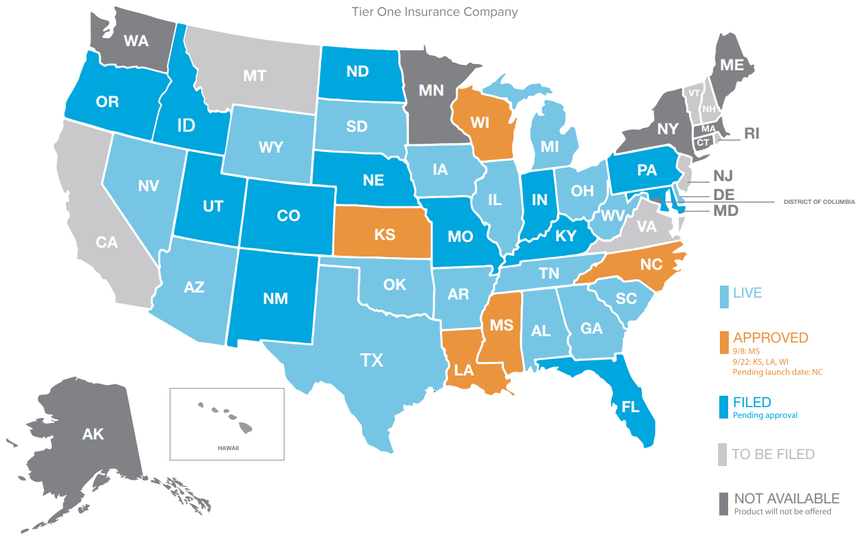
Aflac Medicare Supplement Rollout
[
]
9
See www.sellaflacmedsupp.com for coverage map and additional approved resources.

Slide 14
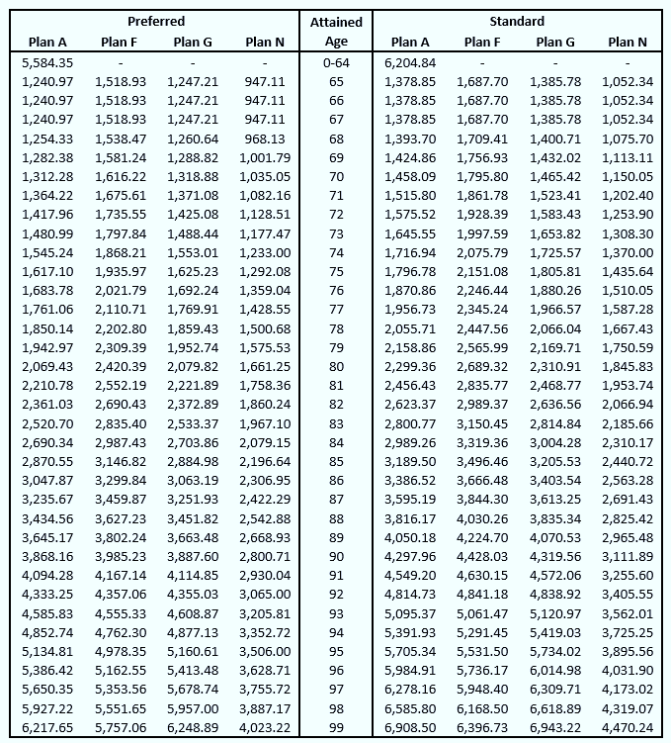
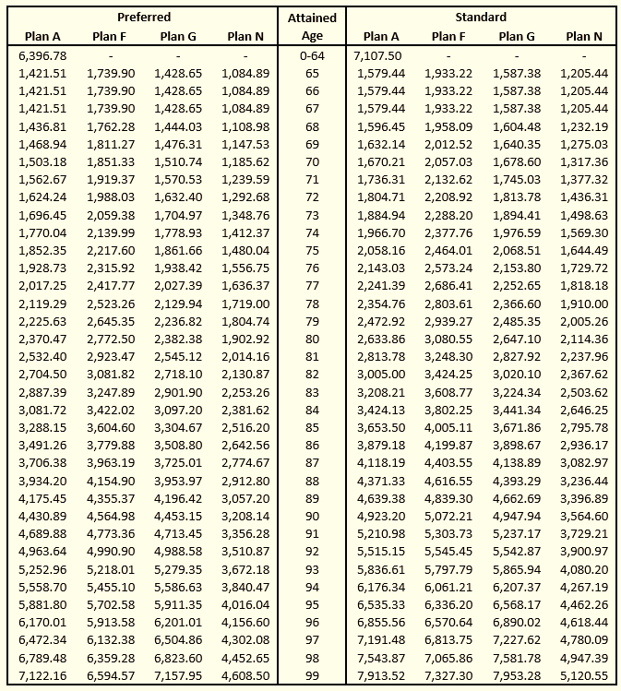
Competitive Premiums
Texas, Female
Texas, Male
Aflac Medicare Supplement insurance was designed to be price competitive with top carriers. The rates shown on this page are offered as an example for both females and males in the state of Texas. However, premiums vary by gender, age and state, refer to each state’s outline of coverage for rates. And in most states, clients are eligible for a household premium discount if they reside with a spouse or have resided with at least one other adult (but not more than three other adults). See full policy details for further information.
9
For agent use only. Not for public use or distribution.

Slide 15
Competitive Compensation
Compensation is competitive and will be assigned based on your commission level.
Production-based Commission Levels
Compensation is competitive and production based.
Check with your upline to see what rates would be available.
9
For agent use only. Not for public use or distribution.

Slide 16
Medicare Supplement
Agent Resource Website
Go to www.sellaflacmedsupp.com for product availability, brochure, and other resources.
This page is for agents only.
8
For agent use only. Not for public use or distribution.

Slide 17
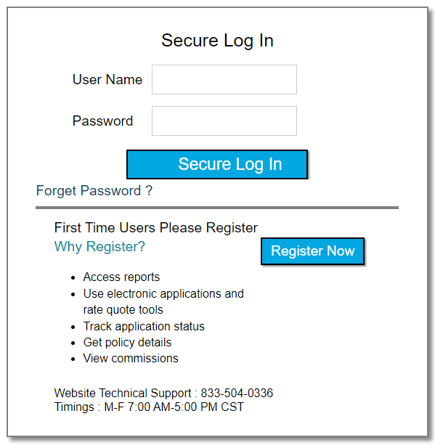
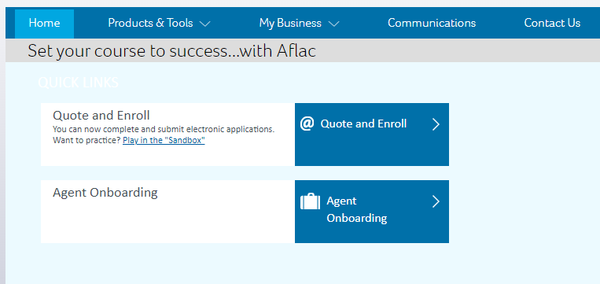
Aflac Senior Agent Portal
Visit the Aflac Senior Agent Portal (orange button at the upper right of the site https://sellaflacmedsupp.com/).
This portal includes the Quote and Enroll tool as well as tools to manage pended business and reporting for your book of business. See the Aflac Sales Guide for more information.
8
For agent use only. Not for public use or distribution.

Slide 18
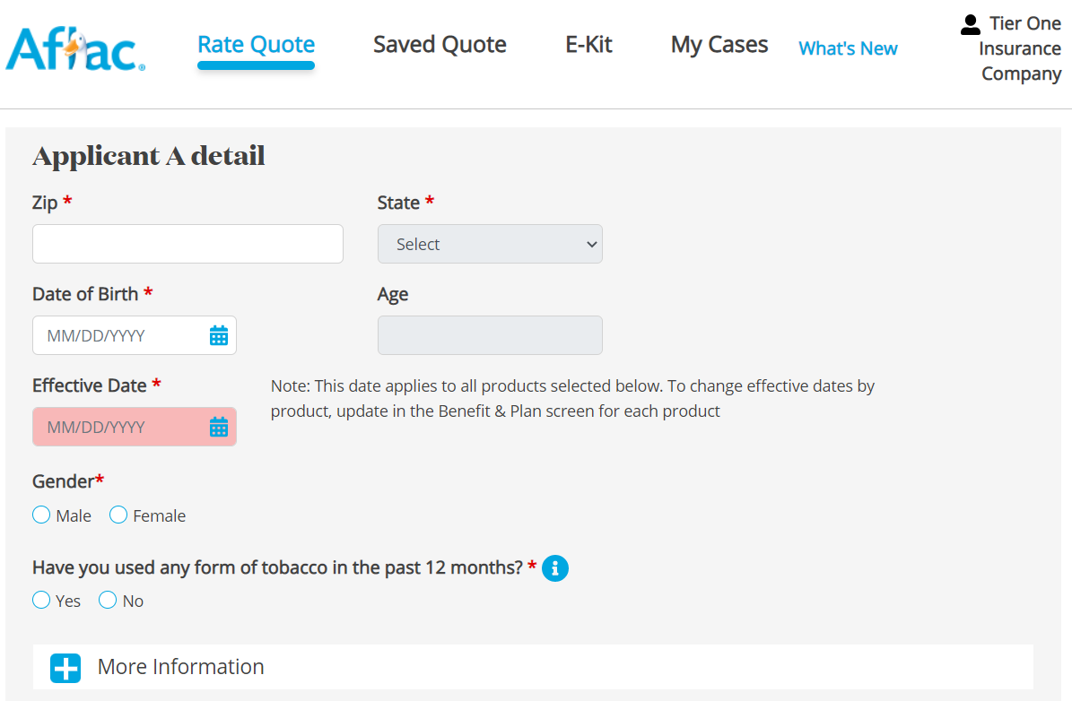
Aflac Senior Agent Portal – Quote and Enroll
See the Aflac Sales Guide for more information.
9

Slide 19
Underwriting
An applicant who can answer “no” to all health conditions on the application will be underwritten. A “yes” answer to these conditions will be an automatic decline. Questions are sometimes answered incorrectly. If it is found that a condition was answered “no” and the answer should have been “yes” the application will result in a decline.
In addition to the application, a prescription history check and the “Drug Information List” are used to determine the insurability of an applicant. Because of the nature of some medications, individuals taking them will be declined, regardless of the severity of the condition. When an applicant is prescribed one of these medications that have multiple uses, the applicant is required to provide the diagnosis for which the medication was prescribed. The application will be considered if it is found that the medication is prescribed for something other than an unacceptable condition.
Applications with explanations of conditions in the Applicant Health History section will be evaluated and may be issued. A Clarifying Telephone Interview may be completed if there is insufficient information on the application to make a decision.
In a small percentage of cases, information in the telephone interview and the application may be insufficient to make an appropriate decision. The case will be reviewed by a Senior Underwriter and the Underwriting Manager to make a decision. A declination or approval may be processed upon review. If a case is questionable after review, the submitting agent may be given the option to provide 3 years medical records for further consideration.
9

Slide 20
Thank you
16
16 ©2022 Aflac and/or one of its affiliates. Confidential and proprietary.

