Slide 1
Not Contracted Yet? Call us today to boost YOUR sales! 800-842-7799
marketing@goldencareusa.com | www.goldencareagent.com
Why GoldenCare?
Perfect Portfolio of Products
Superior, Personal Backend Support
Product and Sales Training
LTC CEO Selling Tools Software
GoldenCare Rewards Program
CSG Actuarial Comparison Tools
StrateCision Comparison Tools
Discounted E&O Coverage
Exciting Promotions On Various Products
CareOptions Health and Wellness Hub
WELCOME!
Thank you for joining us!
For audio, use your computer’s speakers,
OR dial in using the number on your screen.
Coronavirus 6-Pack

Slide 2
GoldenCare’s Coronavirus 6-Pack
Coronavirus & Long-Term Care White Paper, Margie Barrie
LTC Expert Insights: Stephen A. Moses Article, Video & Handout
Statistics on the impact coronavirus has had on Nursing Homes and receiving care
Underwriting ramifications
Scripts to help you address client concerns and close more sales!
Conversation starters

Slide 3
Do You Realize?
Stats:
61% of people surveyed said they would rather die than go into a Nursing Home?
Those receiving care at home, only 3% contracted coronavirus; 1% of those people died.
Those receiving care in a care facility, 37% contracted coronavirus; 11% died.
In less than 3 months, over 22,000 people died in a Nursing Home in CT, MA, NJ, NY and PA – as a direct result of the pandemic.
Of the more than 14,000 Canadian deaths attributed to the pandemic (as of early January [2021]), a heartbreaking 73% were in long-term care and retirement homes.
Your clients are terrified at the prospect of going into a care facility!
Mention LTCi as an option built to keep them OUT of the Nursing Home!

Slide 4
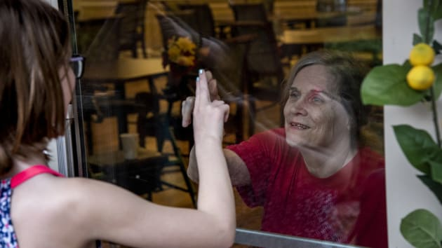
Let’s Face It, Clients Are TERRIFIED They’ll End Up In A Nursing Home!
Here a 78 year-old grandmother says goodbye after chatting via cell phone during a through-the-door visit at a local Assisted Living Facility.

Slide 5
And the statistics may help to explain why.
Impact of COVID-19 on Senior Care Industry
“Approximately 5,000 deaths per week are occurring due to COVID across independent living and assisted living communities and skilled nursing facilities…”
“Although just 1% of COVID cases in the United States have hit people in long-term care, more than 40% of the deaths have occurred in such settings, [AHCA / NCAL President and CEO Mark Parkinson] said.” -- Bowers, Lois, “Recovering from emotional, economic effects of pandemic will dominate senior living in 2021,” McKnight’s Senior Living, January 2021, https://www.mcknightsseniorliving.com/home/news/recovering-from-emotional-economic-effects-of-pandemic-will-dominate-senior-living-in-2021/
“Of the more than 14,000 Canadian deaths attributed to the pandemic (as of early January [2021]), a heartbreaking 73% were in long-term care and retirement homes.” -- Goldberg, Susan, “Long-term care in the age of Covid, and beyond,” Advisor’s Edge, February 2021, https://www.advisor.ca/my-practice/conversations/long-term-care-in-the-age-of-covid-and-beyond/

Slide 6
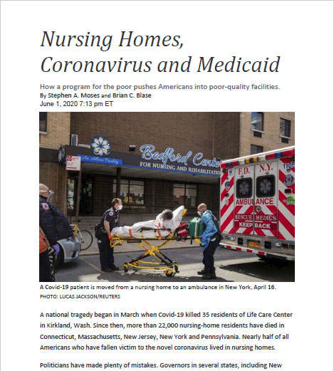
Nursing Homes, Coronavirus and Medicaid
How a program for the poor pushes Americans into poor-quality facilities.
By Stephen A. Moses and Brian C. Blase | June 1, 2020
“A national tragedy began in March when Covid‐19 killed 35 residents of Life Care Center in Kirkland, Wash. Since then, more than 22,000 nursing‐home residents have died in Connecticut, Massachusetts, New Jersey, New York and Pennsylvania. Nearly half of all Americans who have fallen victim to the novel coronavirus lived in nursing homes. …
“Why do so many elderly people live in low-quality nursing homes? Almost no one wants to end up in a nursing home, and most families prefer not to place their loved ones in one. The main answer is the legacy of Medicaid, a Great Society program intended to help the poor.”

Slide 7
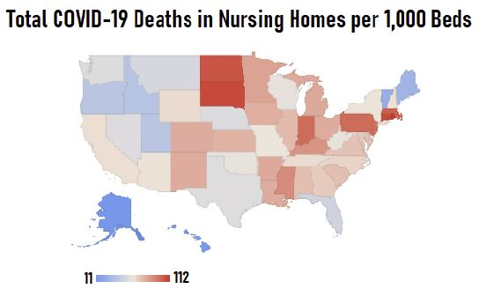
COVID-19 and Long-Term Care: LTCI Insider
Planning for this risk is getting to be even more complicated.
By Margie Barrie | January 30, 2021
“Centers for Medicare and Medicaid Services statistics show that, as of Jan. 17,
COVID-19 had killed at least one nursing home resident for every 100 nursing
home beds in every U.S. state.”
The situation is devastating.
The destructive sweep of the COVID-19 virus which is disrupting our lifestyle and daily lives is significantly impacting those in the throes of a long-term care event. They are especially vulnerable. But that is just the short term.
What are the longer term issues when your clients need long-term care. If they fortunately still have their health and can only contemplate having a major health change down the road, will they be impacted? The answer is unequivocally yes!

Slide 8
LTCi Underwriting Ramifications
Long-Term Care Insurance companies have implemented procedures to address applications submitted by individuals who have been exposed to, or tested positive for, the novel coronavirus.
Initially, the changes seemed to be minimal, but now we’re beginning to see stricter underwriting requirements:
If the applicant or member of their household has traveled outside the US within the past 30 days, applications are being postponed.
If the applicant or member of their household has come into contact with someone who has tested positive, the application may be postponed between 30 to 90 days.
If the applicant has COVID-19 at time of application, depending on the carrier the application may be postponed for 30 – 90 days.
If the applicant has/had COVID-19 and was hospitalized, the application could be delayed for up to 12 months.
If the applicant is quarantined with no diagnosis or symptoms, the delay could range from as soon as the individual is released to 90 days.
Just recently, a carrier announced the availability of Virtual Health Assessments as a way to minimize potential exposure. This option is meant for applicants of a certain age range that meet specific criteria and are otherwise viewed as favorable.

Slide 9
LTCi Sales Script
Basic Script to Open Discussion:
With the current situation, have you had any family or friends over to visit for [the holiday/recent birthday]?
Concerns about spreading the virus are widespread. Even if meeting on Zoom, in person or just speaking to them on the phone, have you felt more isolated because of the pandemic?
Do you mind if I ask whether you know anyone personally that has tested positive?
What was that like for them?
How did testing positive impact that person?
Did they express some of their concerns to you? Being admitted to the hospital, or even to a care facility for more long-term care?
If so, has that helped shape some of your own concerns related to going into a care facility?
The more I see on the news about Nursing Homes, the more I believe people are trying to plan ahead to avoid going into one. There are insurance plans that were designed to do just that, and the cost can be surprisingly affordable.

Slide 10
LTCi Conversation Starters
Were you able to celebrate [recent holiday and/or birthday] with family or friends?
Have you tried doing zoom meetings with family, and what was that like for you?
Are you or anyone you know struggling with the limits on social gatherings? Would you want to talk more about it?
Because of the pandemic, have you tried getting your groceries delivered? Or have you tried the pick-up options at the store?
Does your pharmacy offer safe options for pick-up, like drive-through, delivery, or to bring your medication(s) out to your car?
Do you have any family or loved ones in a Nursing Home or care facility? - Has that person expressed their frustrations about feeling so isolated?
Share a personal story about window-visiting a loved one in a facility and ask if they have an experience they would like to share.

Slide 11
Not Contracted Yet? Call us today to boost YOUR sales! 800-842-7799
marketing@goldencareusa.com | www.goldencareagent.com
Why GoldenCare?
Perfect Portfolio of Products
Superior, Personal Backend Support
Product and Sales Training
LTC CEO Selling Tools Software
GoldenCare Rewards Program
CSG Actuarial Comparison Tools
StrateCision Comparison Tools
Discounted E&O Coverage
Exciting Promotions On Various Products
CareOptions Health and Wellness Hub
Thank you for
joining us today!
For attending, we will send the CE Voucher, copy
of these presentation slides, and more!
Watch your inbox for our email!
Coronavirus 6-Pack

