Slide 1
Not Contracted Yet? Call us today to boost YOUR sales! 800-842-7799
marketing@goldencareusa.com | www.goldencareagent.com
Why GoldenCare?
Perfect Portfolio of Products
Superior, Personal Backend Support
Product and Sales Training
LTC CEO Selling Tools Software
GoldenCare Rewards Program
CSG Actuarial Comparison Tools
StrateCision Comparison Tools
Discounted E&O Coverage
Exciting Promotions On Various Products
CareOptions Health and Wellness Hub
WELCOME!
Thank you for joining us!
For audio, use your computer’s speakers,
OR dial in using the number on your screen.
Social Distancing & Online Tools For Productivity

Slide 2
Introduction:
“Social Distancing” doesn’t have to bring your business to a halt.
We have the tools to keep you productive, while keeping the health and safety of you and your clients’ top-of-mind.
Avoid the sales lull with these online tools:
- Mutual of Omaha e-Applications
- Convenient Access to Quoting Software
- StrateCision LTC/STC & Hybrid Comparisons
- CSG Actuarial
- Medicare Center
- Carrier-specific portals & e-Application access
- Digital Supplies Available For Download

Slide 3
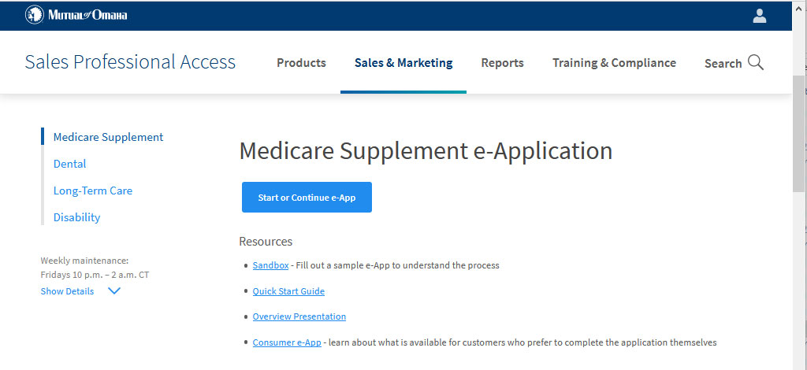
Mutual of Omaha e-Applications:
Mutual of Omaha offers e-App platforms for Medicare Supplement, Dental, Long-Term Care insurance and Disability within their secure agent portal, www.mutualofomaha.com/broker.
Once logged in, click the “Electronic Applications” along the left-hand side under Sales Tools.
REMEMER:
You can also find a direct link to
Omaha’s LTCi e-App (Login required)
from the Mutual of Omaha page on
www.goldencareagent.com.

Slide 4
Convenient Access to LTCi Quoting Software:
Many of the insurance carriers in our portfolio utilize online-based illustration software for Long-Term Care insurance and Hybrid product rates.
You can quickly and easily gain access, or find links for full software download, by visiting www.goldencareagent.com and clicking “Software Download” within the Products tab along the top.

Slide 5
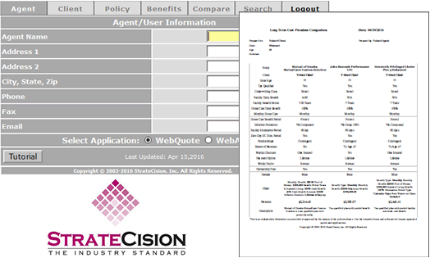
StrateCision Quoting & Comparison Tool:
There are a few big determining factors when it comes to whether a client would be a better fit for a Med Supp or Med Advantage. Here's a side-by-side comparison you can use to find the best coverage for your clients.

Slide 6
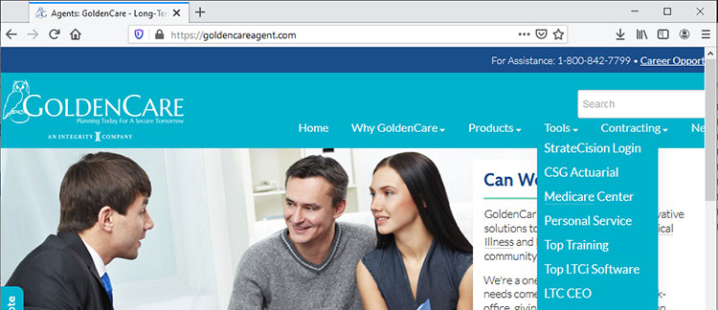
How to Access Each Tool:
Visit our GoldenCare Agent website: www.goldencareagent.com. Select tool from ‘Tools’ drop-down menu.

Slide 7
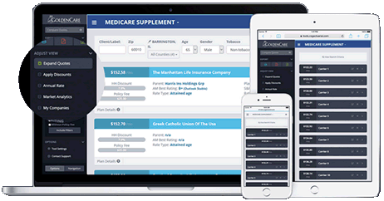
What is CSG Actuarial?
CSG Actuarial is a quoting & comparison tool for Medicare Supplement, Medicare Advantage & PDP. We currently make this available to appointed agents at no charge.
CSG Actuarial recently announced launched a universal, multi-carrier, electronic application. This innovative technology allows you to quote multiple carriers and submit a standardized, carrier-compliant application on the same platform.
Current companies utilizing the CSG Actuarial e-Application Platform:
Mutual of Omaha and Affiliates
Aetna and Affiliates
Heartland National Life Insurance Company
More carriers coming soon!

Slide 8
What is Medicare Center?
Medicare Center is a multi-carrier online enrollment tool, specifically for Medicare Advantage plans. This tool interfaces with state Departments of Insurance and our own data management system, allowing agents to see/enroll the carriers with whom they’re appointed through GoldenCare.
First-Time access requires the agent to use their full National Producer Number (NPN) as the username, and the letters “NPN” followed by the last 4 digits of their NPN as the password.
If access is not granted, you may not be licensed with Medicare Advantage plans/companies through GoldenCare. Contact us and we can help you get started!

Slide 9
Carrier Med Supp e-App Portals:
Remember, many of the Medicare Supplement carriers offer their own e-App platforms within their secure agent portals.
Mutual of Omaha: www.mutualofomaha.com/broker
Transamerica: https://taani.transamerica.com/
Aetna: https://www.aetnaseniorproducts.com

Slide 10
Access Full Training Videos:
Remember, many of the Medicare Supplement carriers offer their own e-App platforms within their secure agent portals.
Mutual of Omaha LTC e-Application Demo: www.mutualofomaha.com/broker
StrateCision LTC Comparison Training: https://taani.transamerica.com/
CSG Actuarial Comparison Tool: https://www.aetnaseniorproducts.com
CSG Actuarial e-Application Demo: https://www.aetnaseniorproducts.com
Medicare Center Training Video:

Slide 11
Not Contracted Yet? Call us today to boost YOUR sales! 800-842-7799
marketing@goldencareusa.com | www.goldencareagent.com
Why GoldenCare?
Perfect Portfolio of Products
Superior, Personal Backend Support
Product and Sales Training
LTC CEO Selling Tools Software
GoldenCare Rewards Program
CSG Actuarial Comparison Tools
StrateCision Comparison Tools
Discounted E&O Coverage
Exciting Promotions On Various Products
CareOptions Health and Wellness Hub
Thank you for
joining us today!
For attending, we will send the CE Voucher, copy of these presentation slides, and more!
Watch your inbox for our email!
Social Distancing & Online Tools For Productivity

